Slide 1
Approximate Trajectory Queries Under the Fréchet Distance
Presented by
John Pfeifer
Research Student, School of IT
Contributors
Dr. Joachim Gudmundsson
Dr. Michael J. Horton
John Pfeifer

Slide 2
Quote
“Everything we hear is an opinion, not a fact. Everything we see is a perspective, not the truth.”
Marcus Aurelius, Roman Emperor, 121-180AD

Slide 3
Agenda
5-Minute Overview
Deeper Dive
Failing Fast
Drawbacks & New Questions

Slide 4
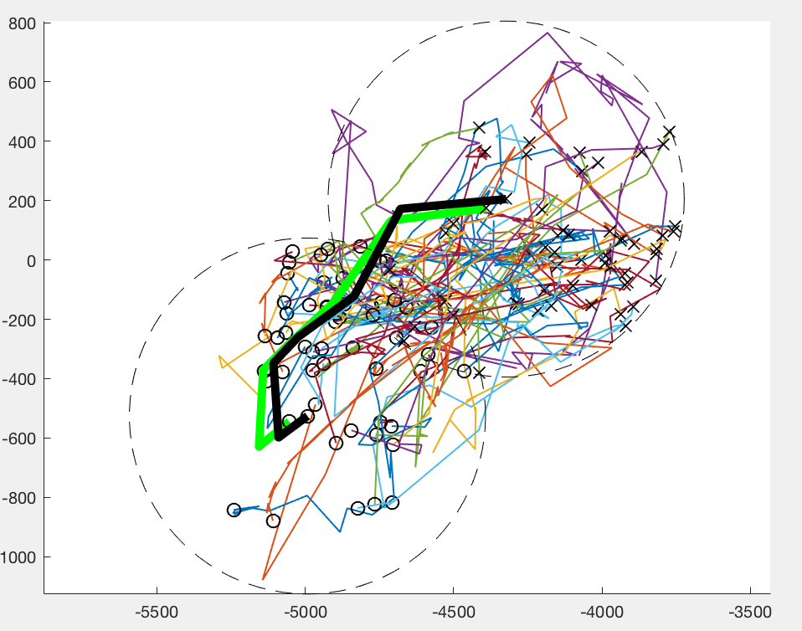
Our Research
We study data structures that support movement queries
More specifically:
Trajectories - the path an object takes as it moves through space & time
NN, kNN, and RNN queries
Use the Fréchet distance
Provides natural distance between two trajectories
But! It’s slow – quadratic runtime

Slide 5
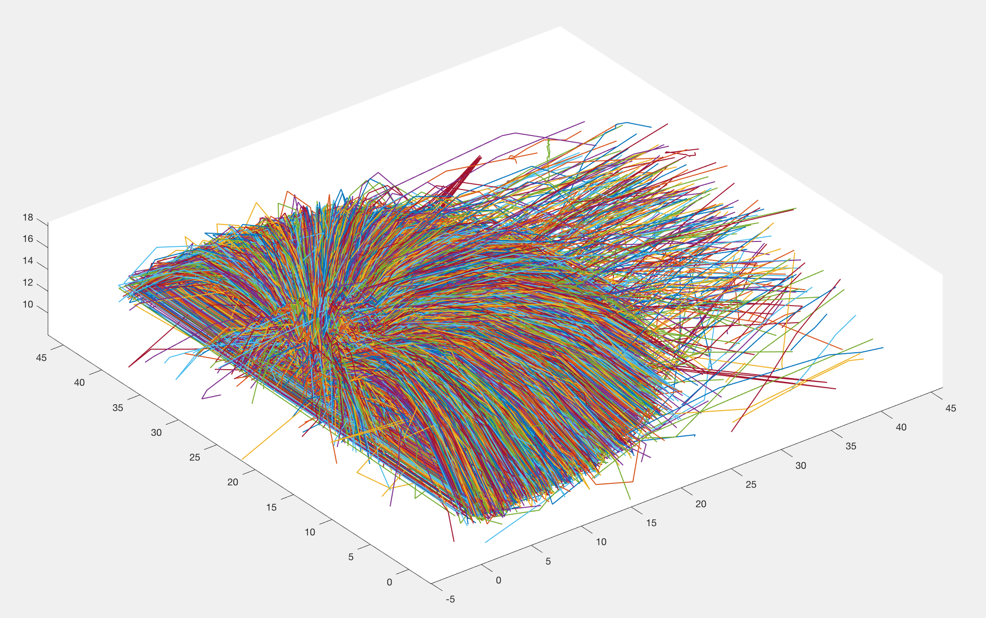
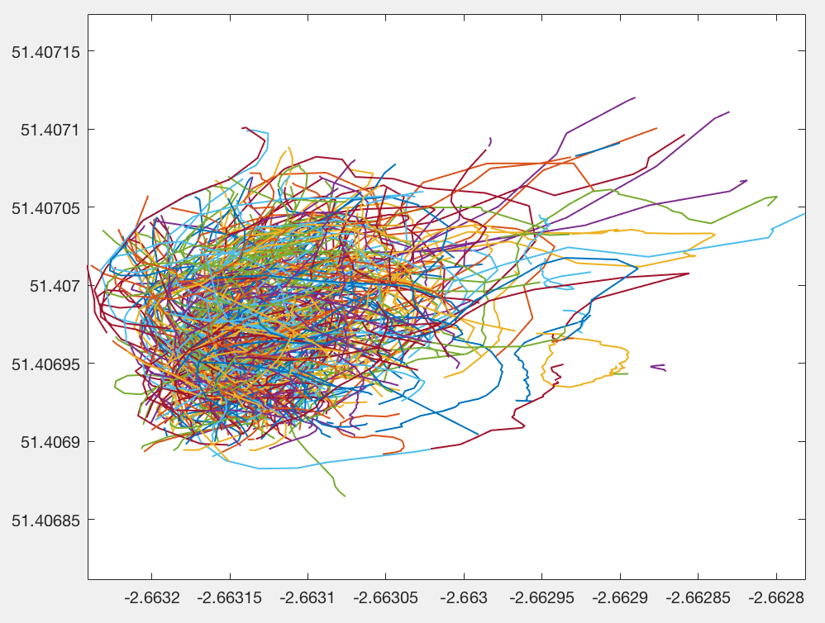
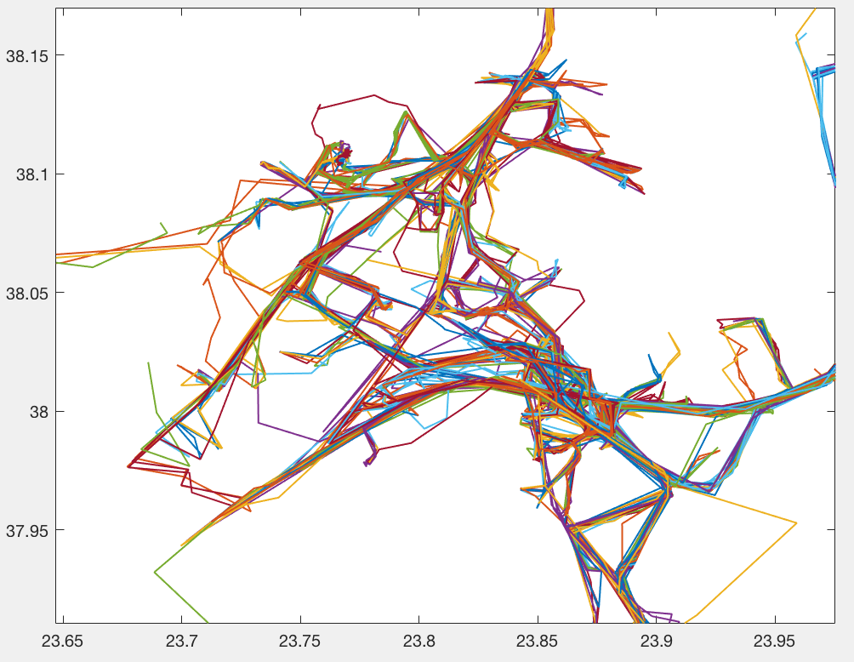
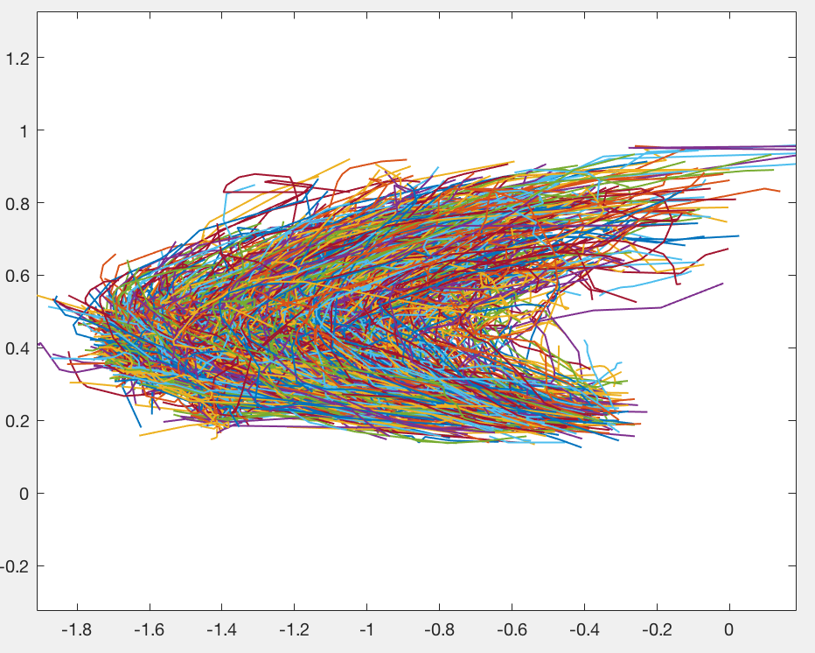
Motivation – Applications for NN Queries
Sports Analysis
Wildlife movement behavior
Vehicles
Atlantic Hurricane

Slide 6
Motivation - Gaps
Is there an efficient data structure that supports approximate Fréchet distance NN, kNN, RNN queries on trajectories?
Try and minimize quadratic Fréchet computations for query
Existing papers all contain at least one drawback:
Only supports one of NN, kNN, RNN [17,18,19]
Exponential build/query time (size of curves) [20,21,25]
Fairly large approximation bounds [21,24,25]
Others: straight lines only, Fréchet variant, constraints on curves [22,23,24,26]

Slide 7
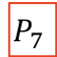
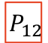
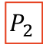
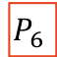
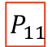
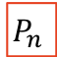

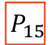

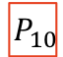

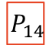

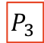
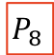

Our Contribution
New or improved upper/lower Fréchet bounds (linear)
New Cluster Centre Tree data structure
$$P_{7}$$
$$P_{12}$$
$$P_{5}$$
$$P_{6}$$
$$P_{8}$$
$$P_{9}$$
$$P_{10}$$
$$P_{11}$$
$$P_{13}$$
$$P_{14}$$
$$P_{15}$$
$$P_{n}$$
$$P_{1}$$
$$P_{2}$$
$$P_{3}$$
$$P_{4}$$

Slide 8
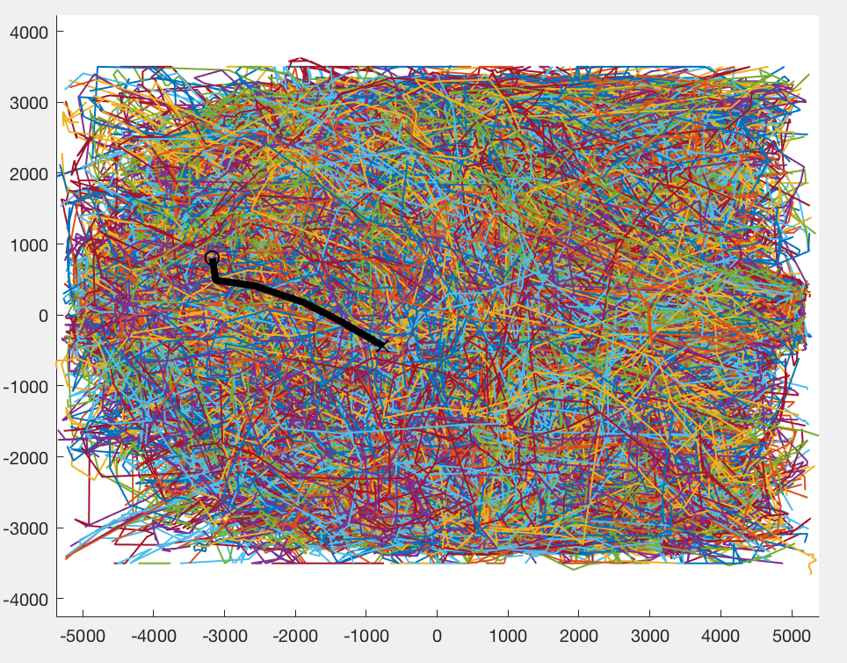
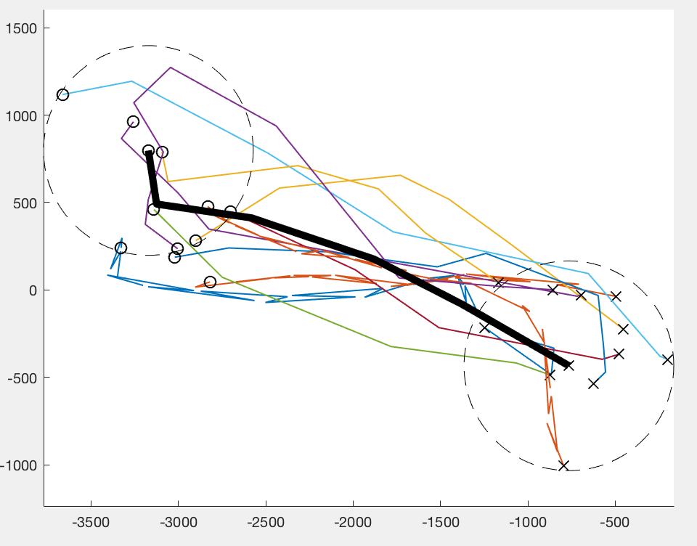
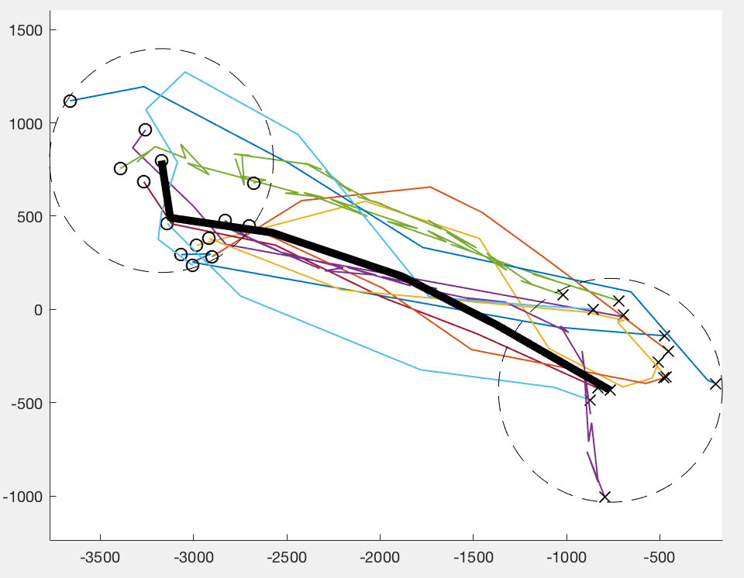
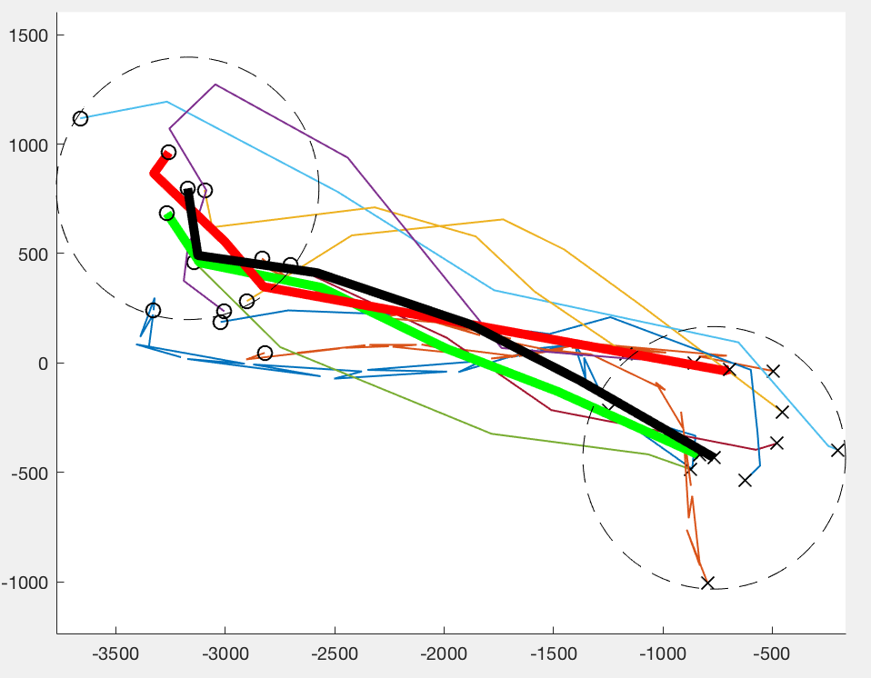
Our Contribution
Convert: Cluster Centre Tree or Cluster Centre Stamp, bounds
Select: bounds & maybe CFD & FDP computations
Prune: Cluster Centre Tree, bounds
→ 14
→ 11
→ 1
18034
Trajectories

Slide 9
Deeper Dive

Slide 10
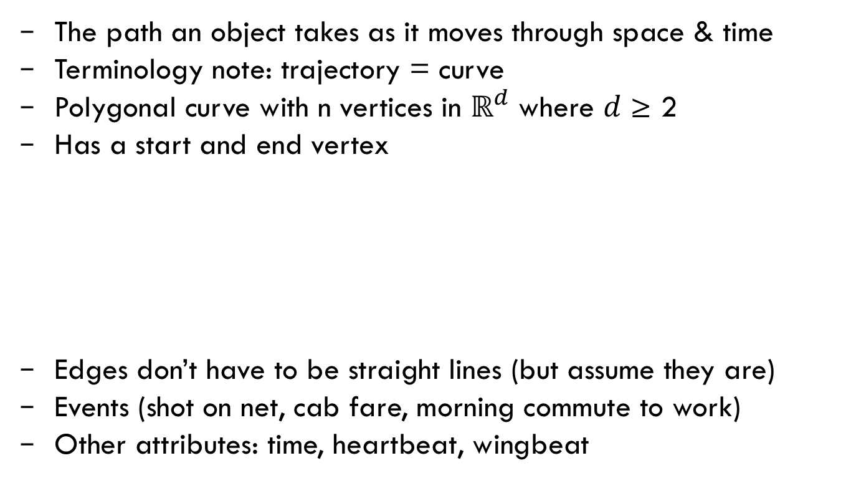
Trajectory
The path an object takes as it moves through space & time
Terminology note: trajectory = curve
Polygonal curve with n vertices in ${\text{ℝ}}^{d}$ where $d$ ≥ 2
Has a start and end vertex
Edges don’t have to be straight lines (but assume they are)
Events (shot on net, cab fare, morning commute to work)
Other attributes: time, heartbeat, wingbeat
5
1
3
2
Edge
4
6
Vertex

Slide 11
Relatively Large Datasets
Tens of thousands of curves
Each curve can contain thousands of vertices

Slide 12
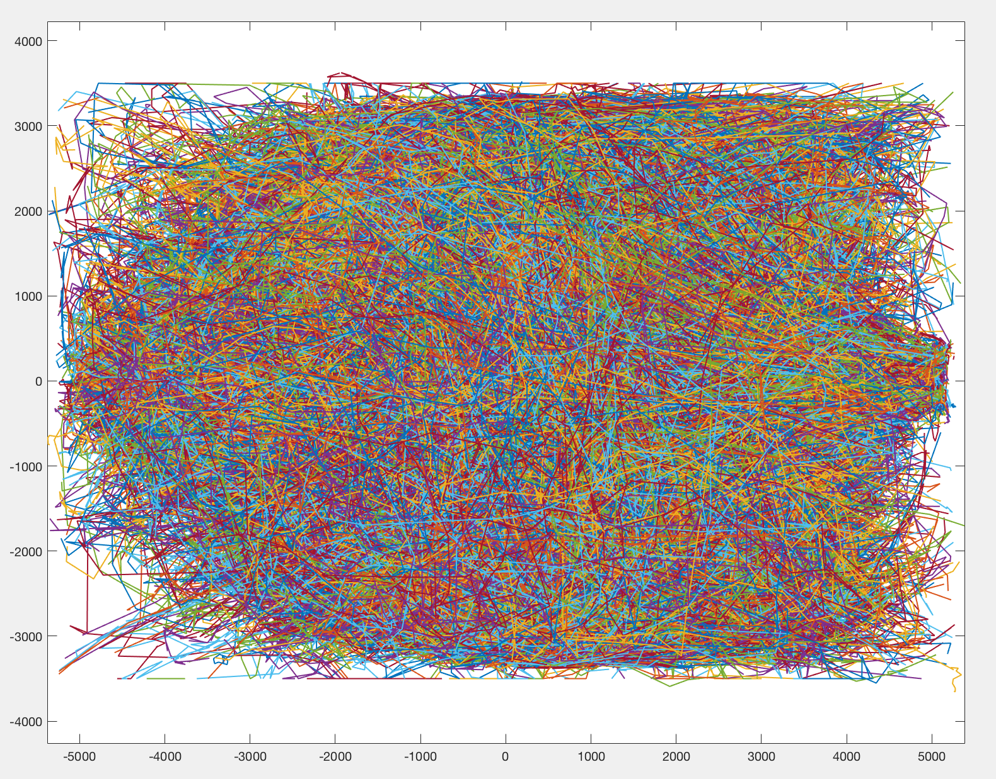
18034 Football Player-possession Curves

Slide 13
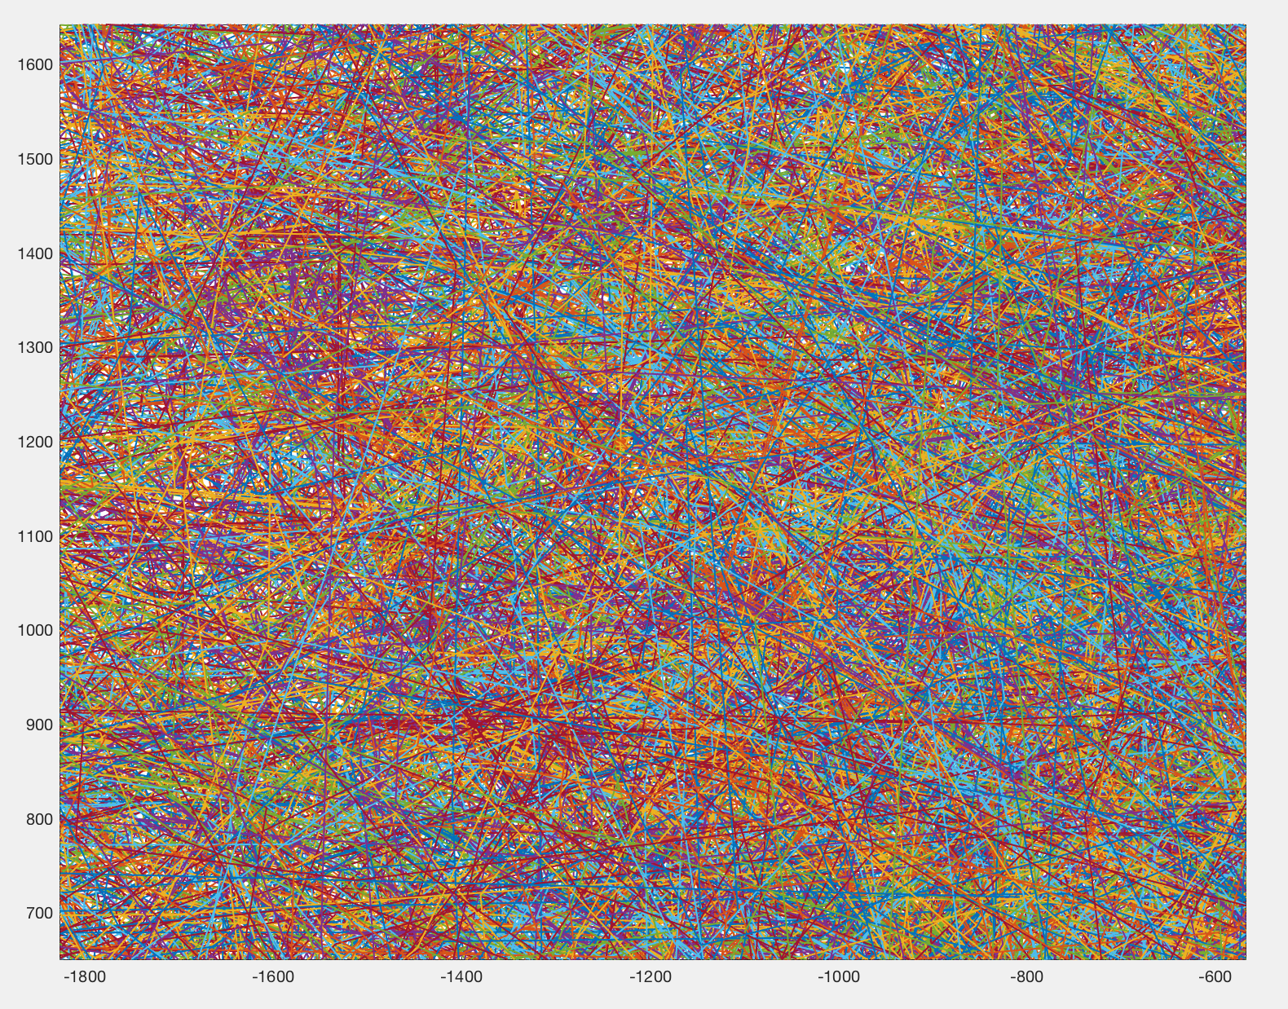
18034 Football Curves – Zoom 1

Slide 14
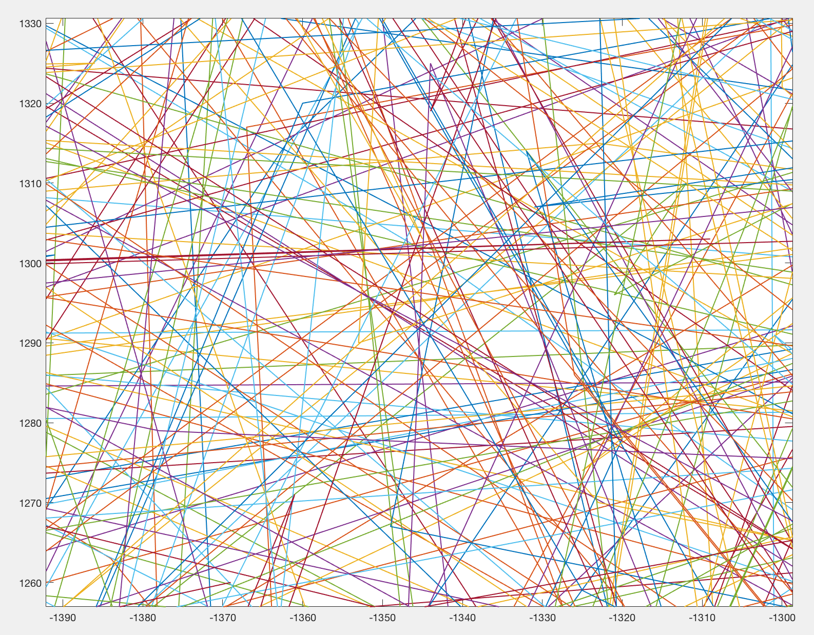
18034 Football Curves – Zoom 2

Slide 15
20780 NBA Basketball Shots on Net

Slide 16
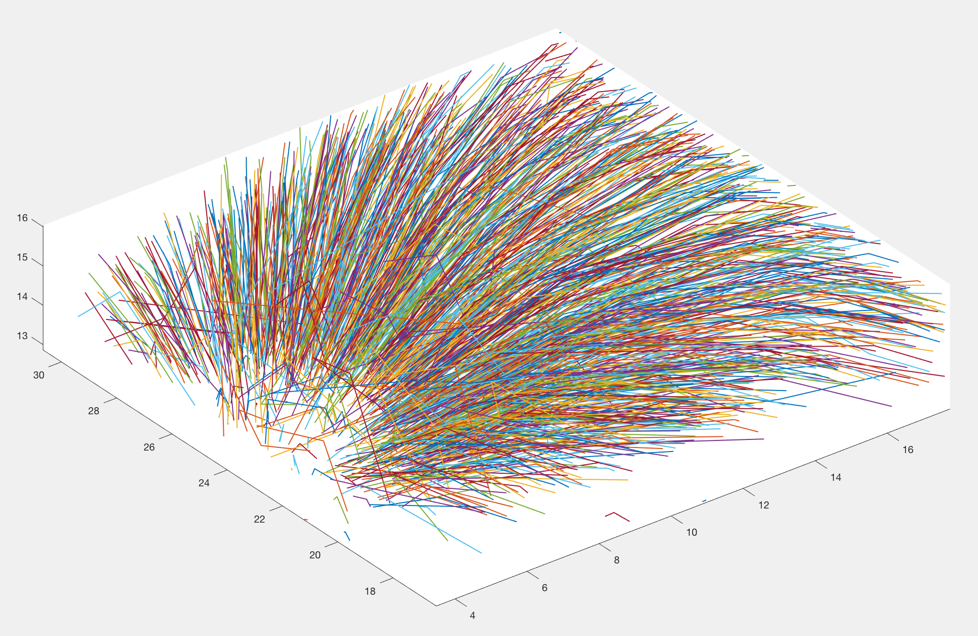
20780 NBA Basketball Shots - Zoom

Slide 17
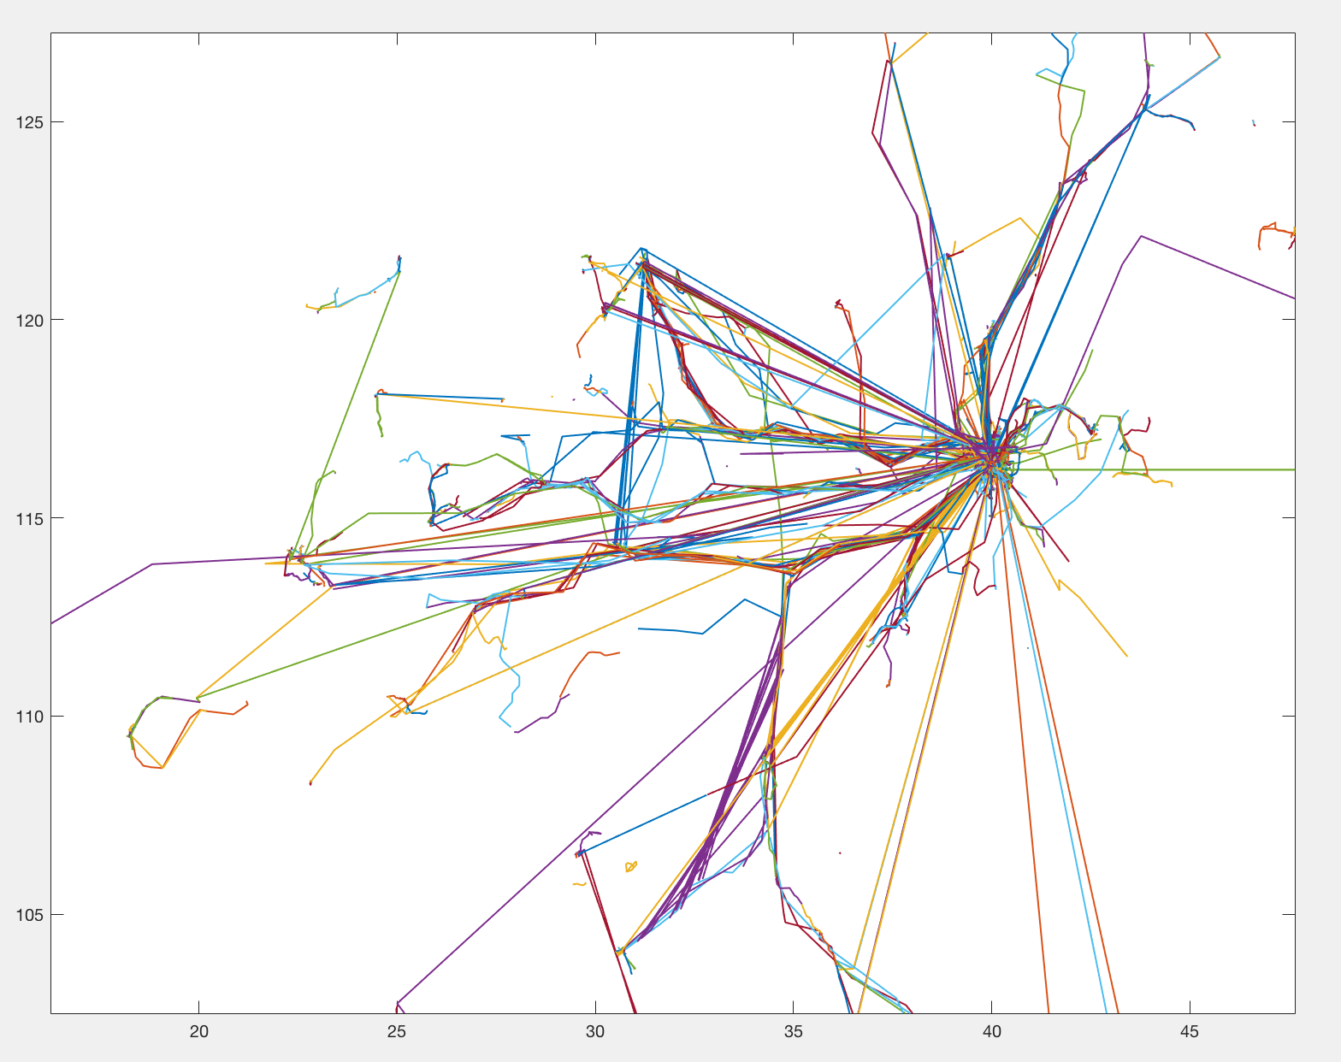
18670 People trajectories

Slide 18
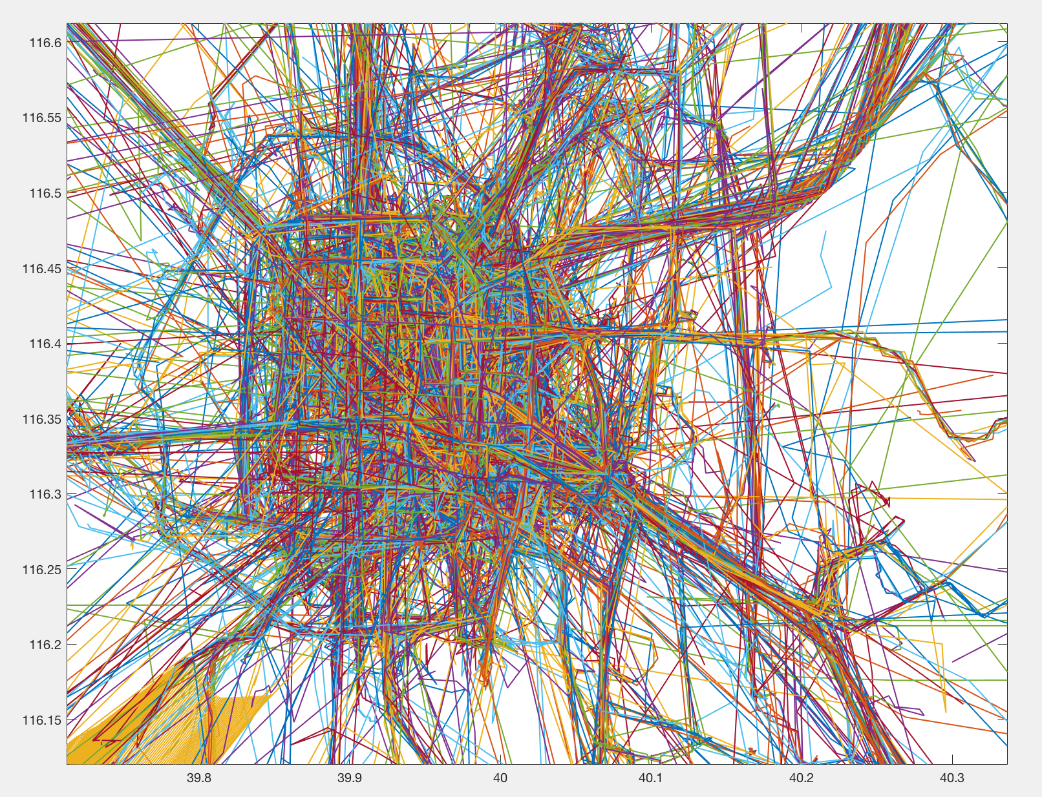
18670 People trajectories – Zoom 1

Slide 19
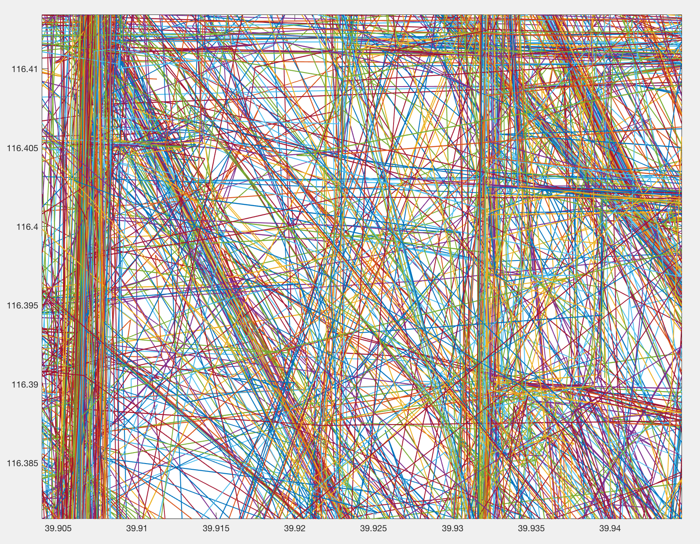
18670 People trajectories – Zoom 2

Slide 20
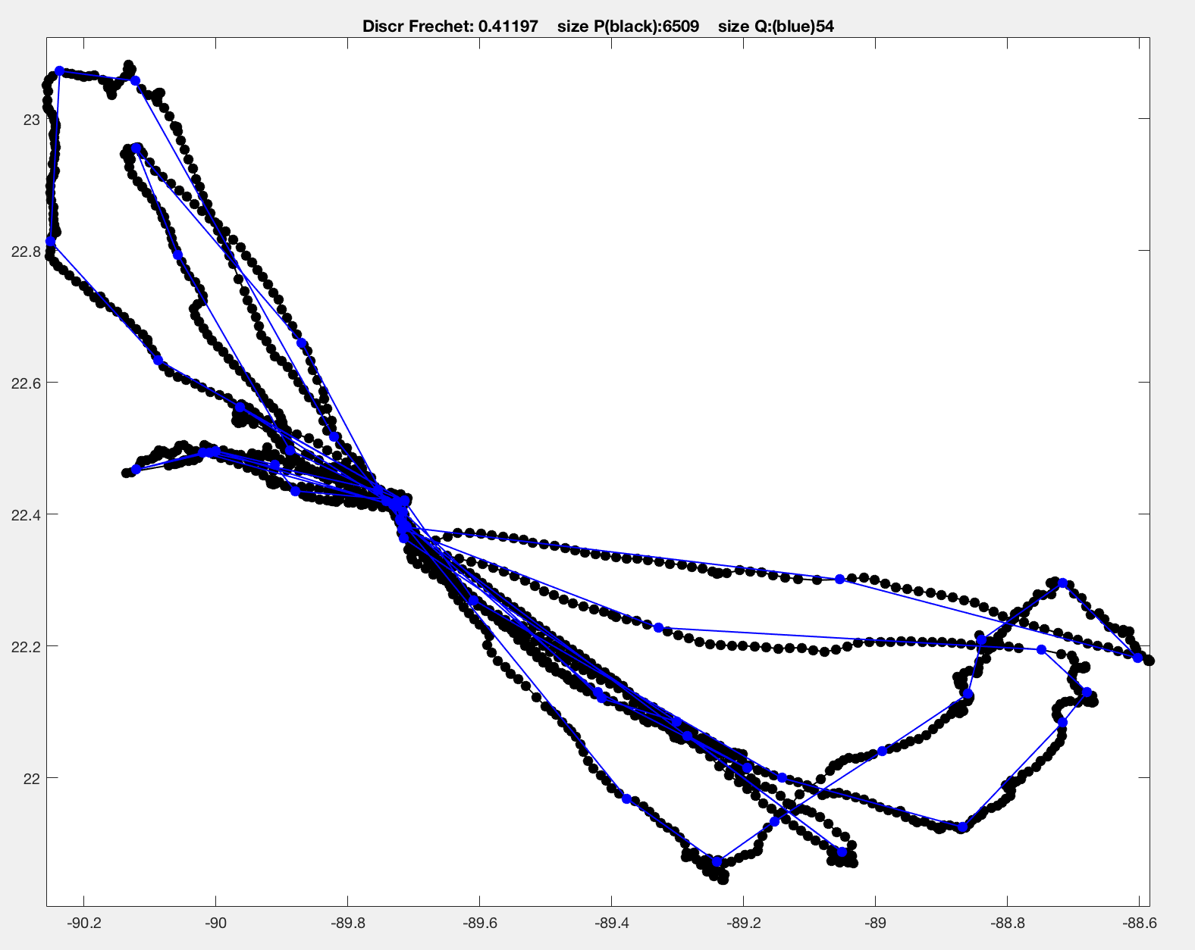
Bird curve – 6509 vertices

Slide 21
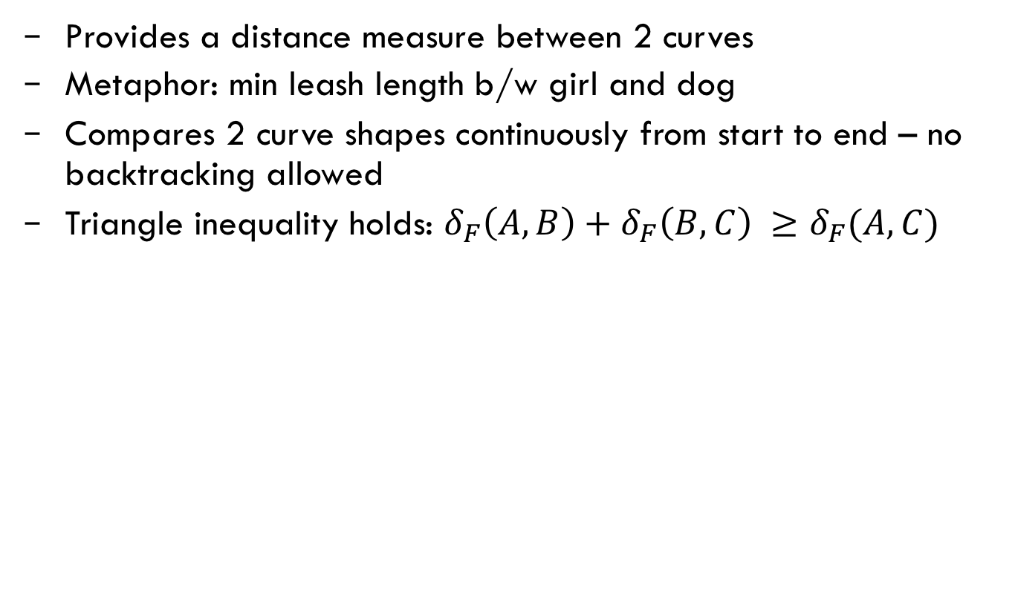
Fréchet Distance
Provides a distance measure between 2 curves
Metaphor: min leash length b/w girl and dog
Compares 2 curve shapes continuously from start to end – no backtracking allowed
Triangle inequality holds: $δ_{F}\left(A,B\right)+δ_{F}\left(B,C\right) ≥δ_{F}(A,C)$
n
1
2
1
2
m

Slide 22
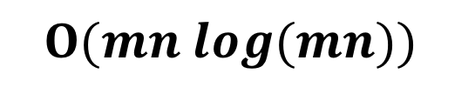
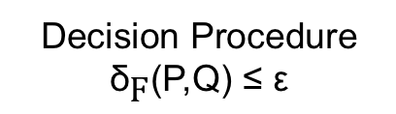
Fréchet Distance – CFD, FDP
Does not measure time - only compares 2 curve shapes continuously from start to end
m & n are number of vertices in curves Q & P resp.
$$Ο(mn log(mn))$$
Decision Procedure
$${\text{δ}}_{\text{F}}\text{(}\text{P}\text{,}\text{Q}\text{) ≤ }\text{ε}$$

Slide 23
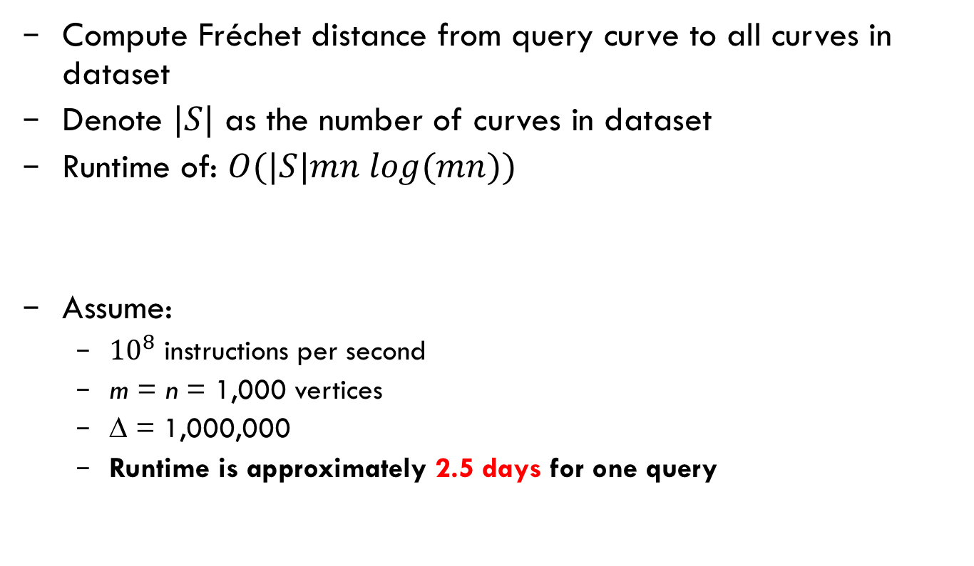
Naïve Exact NN/kNN/RNN Query Method
Compute Fréchet distance from query curve to all curves in dataset
Denote $|S|$ as the number of curves in dataset
Runtime of: $Ο(|S|mn log(mn))$
Assume:
${10}^{8}$ instructions per second
m = n = 1,000 vertices
∆ = 1,000,000
Runtime is approximately 2.5 days for one query

Slide 24
What do Algorithm Computer Scientists Do?
We discover and apply theoretical bounds to solve problems
We find/use upper & lower bounds to speed up runtime

Slide 25


Our Contribution
1. Prune
Candidate Curves
Cluster Centre Tree
Candidate
Cluster
Centres
Cluster Centre Stamp
Bounds
2. Convert
CFD
FDP
3. Search
Final Results

Slide 26
Our Contribution – Measure Performance
Data Structure build:
Number of CFD and FDP computations
Queries:
Pruning: number cluster centre tree nodes accessed
Approximation: size of candidate curves and candidate cluster centres
Number of CFD and FDP computations

Slide 27
Our Contribution
I’ll talk about:
Bounds
Data Structures
Pruning
Candidate Clusters
Queries

Slide 28
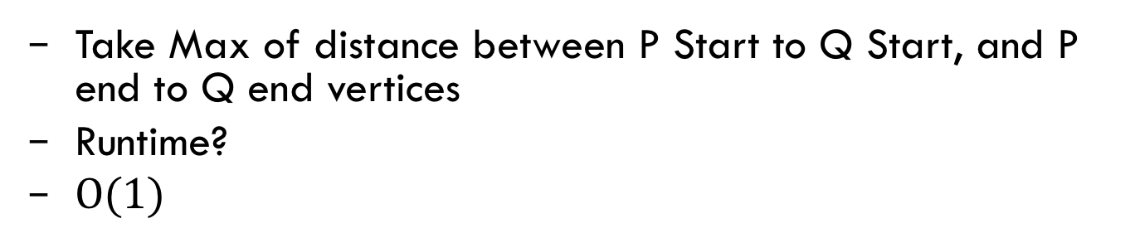
Bounds – Start & End Vertices
Take Max of distance between P Start to Q Start, and P end to Q end vertices
Runtime?
$Ο(1)$
n
1
P
2
Q
1
2
m

Slide 29
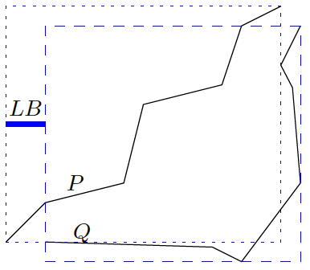
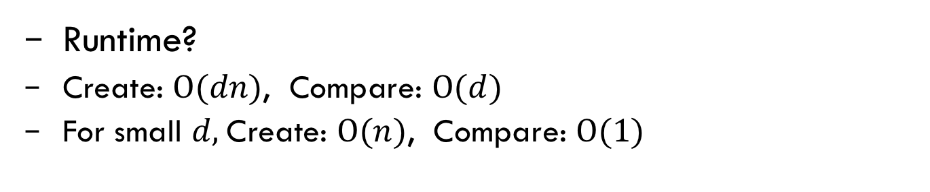
Bounds – Axis Aligned Bounding Box
Runtime?
Create: $Ο(dn)$, Compare: $Ο(d)$
For small $d,$Create: $Ο(n)$, Compare: $Ο(1)$

Slide 30
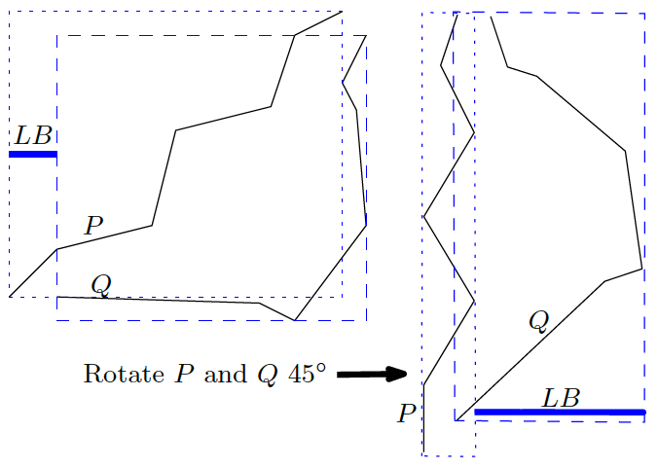
Bounds – Rotate Curves from origin

Slide 31
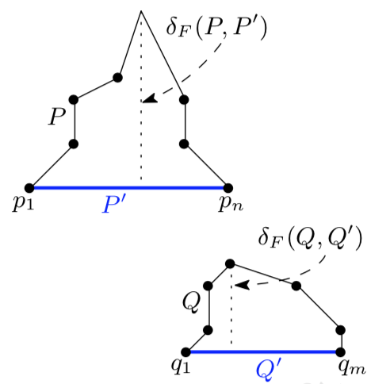
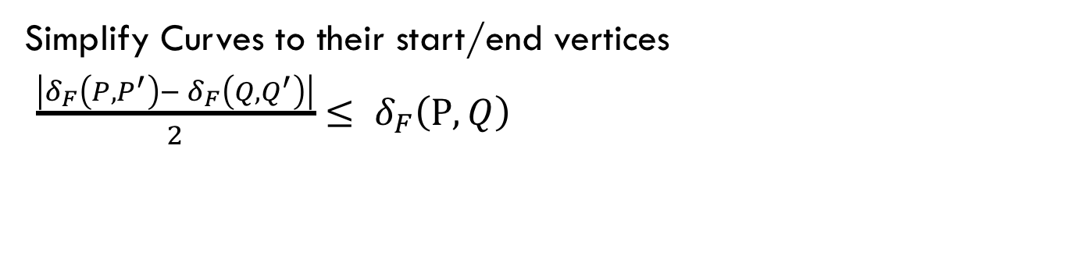
Bounds – Simplified Single Edge
Simplify Curves to their start/end vertices
$\frac{\left|δ_{F}\left(P,P^{′}\right)− δ_{F}\left(Q,Q^{′}\right)\right|}{2}$ $≤ δ_{F}\left(P,Q\right)$

Slide 32
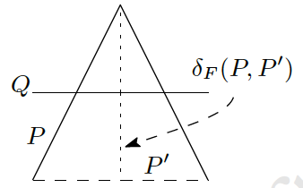
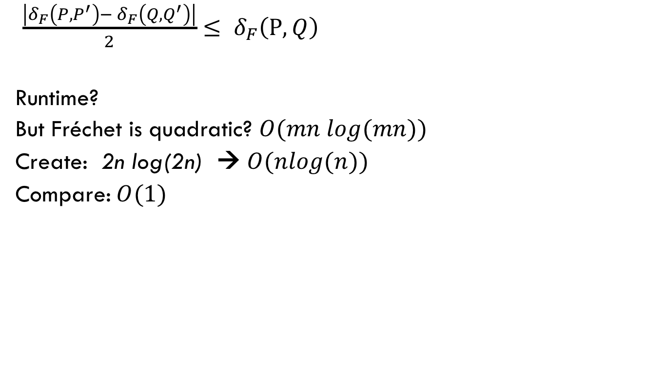
Bounds – Simplified Single Edge
$\frac{\left|δ_{F}\left(P,P^{′}\right)− δ_{F}\left(Q,Q^{′}\right)\right|}{2}$ $≤ δ_{F}\left(P,Q\right)$
Runtime?
But Fréchet is quadratic? $Ο(mn log(mn))$
Create: 2n log(2n) → $Ο(nlog(n))$
Compare:$Ο(1)$

Slide 33
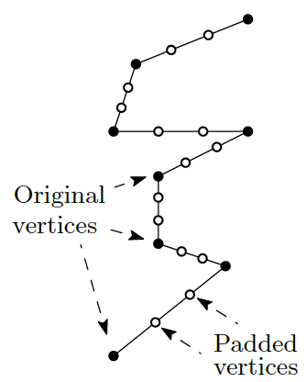
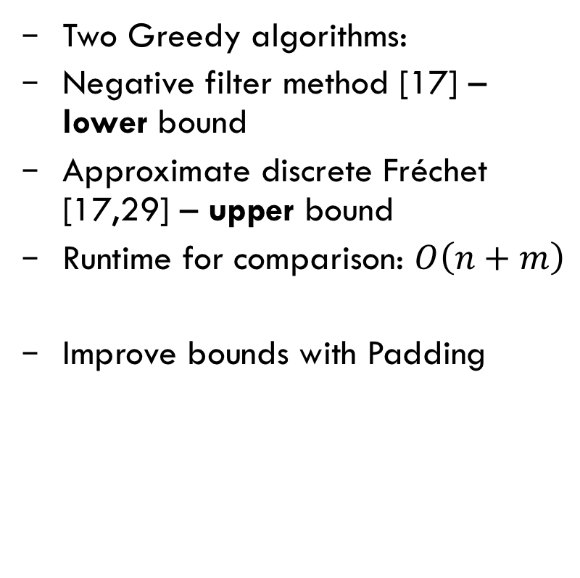
Bounds - Padding
Two Greedy algorithms:
Negative filter method [17] – lower bound
Approximate discrete Fréchet [17,29] – upper bound
Runtime for comparison: $Ο\left(n+m\right)$
Improve bounds with Padding

Slide 34
Bounds – exact CFD
What if upper bound = lower bound?
Then we have computed the CFD!

Slide 35

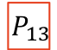
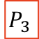

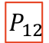
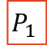



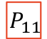

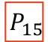
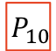



Cluster Centre Tree - Build
$$P_{7}$$
$$P_{12}$$
$$P_{5}$$
$$P_{6}$$
$$P_{8}$$
$$P_{9}$$
$$P_{10}$$
$$P_{11}$$
$$P_{13}$$
$$P_{14}$$
$$P_{15}$$
$$P_{n}$$
$$P_{1}$$
$$P_{2}$$
$$P_{3}$$
$$P_{4}$$

Slide 36


Cluster Centre Tree - Build
Arbitrarily choose a traj as the Centre
Compute CFD to all other traj
Now we know the furthest traj
Now figure out what traj belong to which centre:
Triangle inequality
Upper/lower bounds
FDP, CFD
Build runtime w.r.t. CFD ?
$Ο({|S|}^{2})$
Not good if 1M traj!

Slide 37

Cluster Centre Tree - Size
Each node contains: Centre Traj, Furthest Traj, $rad(c)$
Size?
$Ο(|S|)$
$$P_{7}$$
$$P_{12}$$
$$P_{5}$$
$$P_{6}$$
$$P_{8}$$
$$P_{9}$$
$$P_{10}$$
$$P_{11}$$
$$P_{13}$$
$$P_{14}$$
$$P_{15}$$
$$P_{n}$$
$$P_{1}$$
$$P_{2}$$
$$P_{3}$$
$$P_{4}$$

Slide 38
Cluster Centre Stamp
Use Gonzalez [28] cluster approximation algorithm

Slide 39
Cluster Centre Stamp

Slide 40
Cluster Centre Stamp

Slide 41
Cluster Centre Stamp

Slide 42


Cluster Centre Stamp
“Stamp” out the state of the clusters whenever number of centres is a power of 2, until each cluster has one traj.
Size?
$Ο(|S| log(|S|))$

Slide 43

Cluster Centre Stamp – Cluster Bounds
Build runtime w.r.t. CFD ?
$Ο({|S|}^{2})$
Yikes!

Slide 44

Cluster Centre Stamp – Cluster Bounds

Slide 45

Cluster Centre Stamp – Cluster Bounds
Build runtime w.r.t. CFD ?
$Ο({|S|}^{2})$
But…

Slide 46
Pruning
Uses the Cluster Centre Tree
Uses only upper/lower bounds, not CFD
Should quickly select a set of candidate curves
Should be faster than a linear search of all curves
Two types of pruning:
NN
kNN/RNN (requires a pruning threshold)

Slide 47















NN Pruning
Greedy, recursive dive into Cluster Centre Tree
Keeps track of the current best (smallest) upper/lower bounds
Gets better and better at pruning (eliminating nodes)
Keeps list of candidate curves
$$P_{7}$$
$$P_{12}$$
$$P_{5}$$
$$P_{6}$$
$$P_{8}$$
$$P_{9}$$
$$P_{10}$$
$$P_{11}$$
$$P_{13}$$
$$P_{14}$$
$$P_{15}$$
$$P_{n}$$
$$P_{1}$$
$$P_{2}$$
$$P_{3}$$
$$P_{4}$$

Slide 48








NN Pruning
Candidate curves
0
$$∞$$
$$P_{1}$$
$$P_{2}$$
$$P_{3}$$
$$P_{4}$$
$$P_{5}$$
$$P_{6}$$
$$P_{j}$$

Slide 49

Candidate Clusters
Transform candidate trajectories to candidate clusters
Use an approximation threshold $ε_{apx}$
Use either Cluster Centre Tree or Cluster Centre Stamp
→ 14
→ 11

Slide 50








Candidate Cluster – Cluster Centre Tree
For each candidate trajectory:
Find largest node where $rad(c)≤ε_{apx}$, get cluster centre
$$P_{7}$$
$$P_{12}$$
$$P_{5}$$
$$P_{6}$$
$$P_{8}$$
$$P_{9}$$
$$P_{10}$$
$$P_{11}$$
$$P_{13}$$
$$P_{14}$$
$$P_{15}$$
$$P_{n}$$
$$P_{1}$$
$$P_{2}$$
$$P_{3}$$
$$P_{4}$$
Start at leaves and go towards root

Slide 51

Candidate Cluster – Cluster Centre Tree

Slide 52


Candidate Cluster – Cluster Centre Stamp
Find largest stamp where max$rad(c)≤ε_{apx}$
Get cluster centre for each candidate trajectory
$$Max rad(c)$$
$$rad(c)$$
$$rad(c)$$
$$rad(c)$$

Slide 53









Queries - NN
Invoke the NN Pruning algorithm
Convert candidate trajectories to candidate cluster centres
Upper bound $≤ ε_{apx}$ ?
Might be able to eliminate some cluster centres
Now have to do CFD and FDP computations
$$ε_{apx}$$
0
$$∞$$
$$P_{1}$$
$$P_{2}$$
$$P_{3}$$
$$P_{4}$$
$$P_{5}$$
$$P_{6}$$

Slide 54

Queries - Guarantees
NN: reports a curve that is at most $ε_{apx}$ greater CFD distance from Q, compared to the exact closest curve.
kNN: reports k curves, where furthest curve is at most $ε_{apx}$ greater CFD distance from Q, compared to the exact k-furthest curve
RNN: reports all curves that are up to CFD distance $ε_{lmt}$ from Q, and may contain curves which are up to an additional $ε_{apx}$ distance.

Slide 55

Results – NN using Cluster Centre Tree

Slide 56


Results - NN query vary ${\text{ε}}_{apx}$ Yangtze Vessel dataset

Slide 57

Results - randomly sampled traj. Taxi dataset

Slide 58

Results – Data Structure Build Performance

Slide 59

Results – Cluster Centre Tree Depth

Slide 60
Our Solution has some Drawbacks
Does not support sub-trajectory queries
Requires a “prune threshold” parameter for kNN which can be cumbersome
Approximation threshold is ineffective if relatively small
Number of tree nodes searched for the Taxi dataset is relatively large for RNN queries
Tree is relatively unbalanced for the Taxi and Geolife datasets
More processing time is spent on pruning if the average number of CFD or FDP computations is very small

Slide 61
New Questions
Are there solutions to some of the drawbacks?
Is it possible to dynamically insert/delete curves in the cluster data structures? Query performance impact?
Are there better cluster techniques that result in faster queries?

Slide 62
Failing Fast
Values extensive up-front thought and incremental development/testing to determine whether an idea has value
Cut losses fast and quickly try something else
I used this concept extensively in Agile software development

Slide 63
Failing Fast: Sample Failures
Grid-based Inverted list – only works fast for sparse high dimensional data, and doesn’t correctly measure the Fréchet distance
Anchor curves – compare query to several ”anchors” to help locate position and near neighbors, works but is slow and has no theoretical guarantees
Geometric hashing – grid based hashing of trajectory data, the number of canonical trajectories you need to create is typically too large, so it’s slow
Trajectory complexity fingerprint – may have some value but unsure if there are theoretical bounds
Simplification Signature – takes time to compute for query
There were more…

Slide 64
Quote
“The hard, but just rule, is that if the ideas do not work, then you must throw them away.”
Carl Sagan, Astronomer, 1934-1996

Slide 65
A Final Thought

Slide 66
A Final Thought

Slide 67

Thanks!

Slide 68

Thanks!

Slide 69

Thanks!

